Slide 1
Amazon AWS setting
Installed MySQL
Installed Python

Slide 2
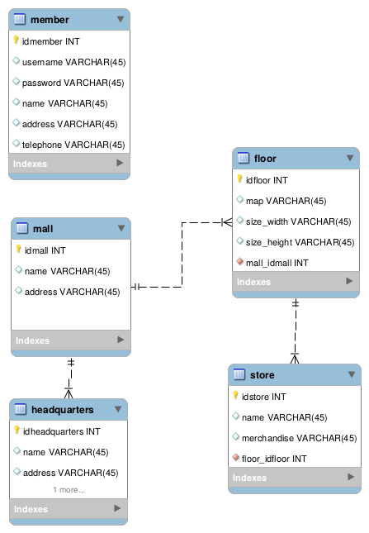
Database design

